Slide 1





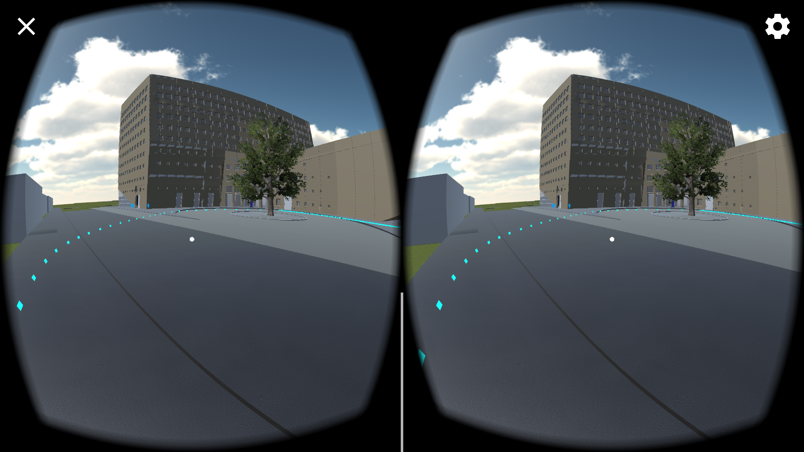
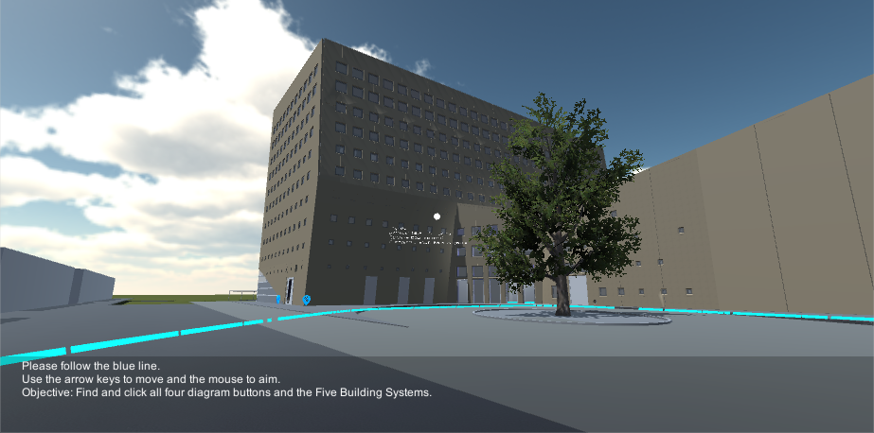
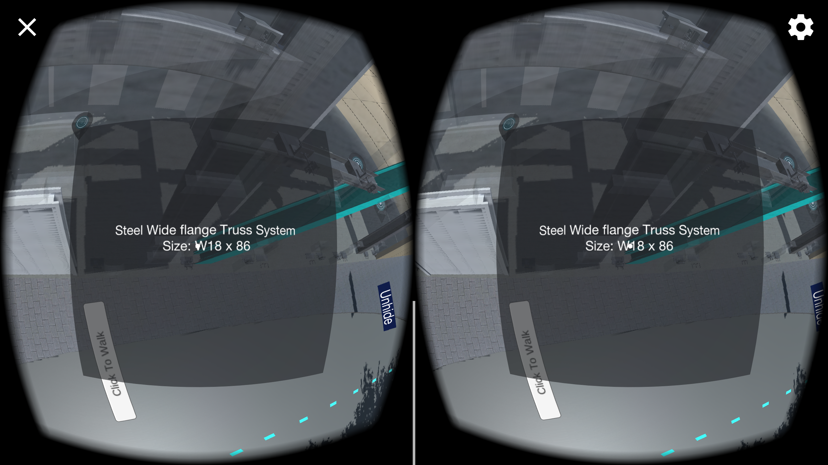
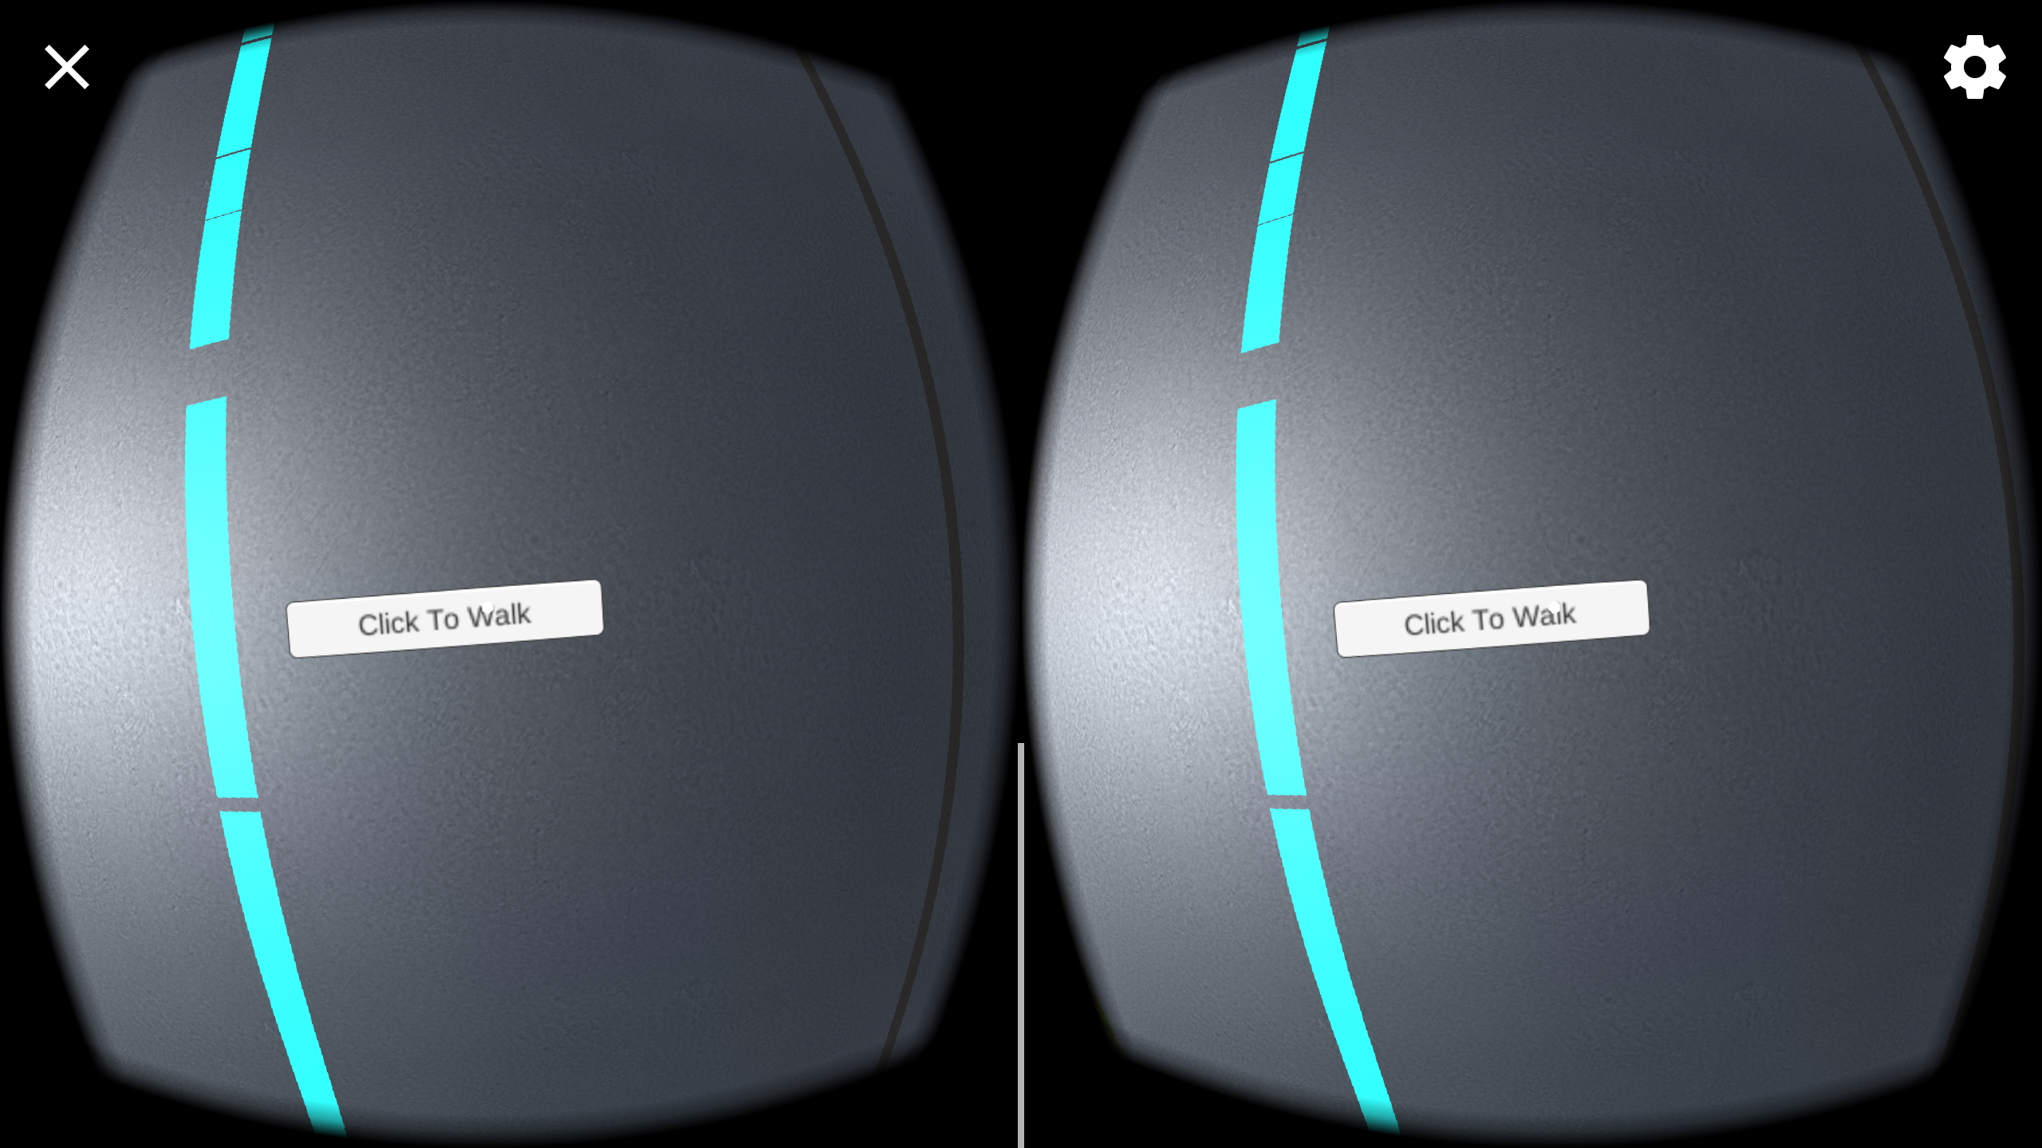



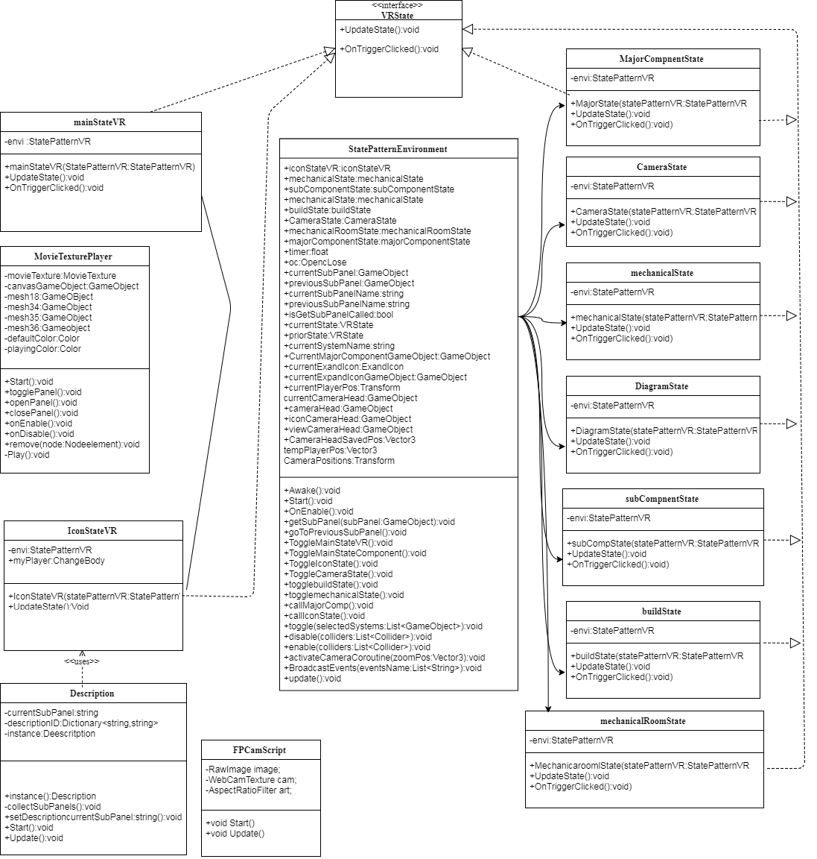

School of Computing & Information Sciences
Senior Project, 2017, Summer
Learning with Virtual Reality
Student: Edvin Li, Florida International University
Mentor: Shahin Vassign, Florida International University
Instructor: Masoud Sadjadi, Florida International University
Lacking support for their mobile platform. Does not have cross platform compatibility
A way to alternate between Virtual Reality application and mobile application. (1 and 2)
Mobile devices lack a way to move around the virtual environment (4)
Solution
Create a build for mobile devices such as Android and iOS.
Used APK for cross compatibility and built application using iOS and Android SDKs.
Added touch input for interaction as well as touch input for movements (3 and 4)
Enable VR and mobile device toggling. A toggle option was created to switch POV. (1 and 2)
Current System
System can now take user input base on touch input while hovering over icons. (3)
System and now register touch inputs to start movement. (4)
System can now toggle between VR view and mobile view. (1 and 2)
System is now built on both iOS and Android.
Problem
Solution
Current System
Screenshots
Screenshots
1
VR view of app
2
Normal view of app
3
Icon Interaction
4
Player Movement
Requirements
Ability for users to run the movement scripts by holding down two fingers on screen.
Toggle between VR view and mobile view while still displaying model and icons.
Application must be built to iOS.
Application must be built to Android.
Application must track camera using a first person point of view.
System Design
Implementation
Requirements
System Design
Unity Game Engine used for models and controllers
Developed for Android. Used Android Studio.
Visual Studio 2017 for framework and editing.
Object Design
Application is written in C# scripts.
Object Design
F
ID: Learning_VR_Movement
Purpose:
To test the ability for the camera to move forward based on touch input.
Preconditions:
The application has fully loaded.
The user has tapped the application with two fingers.
Expected Output:
The first person view starts to move forward and continues to render the scene.
Summary
The Skope VR application for mobile now minimally supports most functionality of its Unity PC counterpart.
The ability to interact with the environment and explore it is possible on mobile devices.
The application is now capable of being demoed and distributed for real use and public testing.
Other minor quality of life changes were implemented.
Verification
Summary
Acknowledgement
The material presented in this poster is based upon the work supported by Albert Elias and Shahin Vassign. I am thankful to the help that I received from my group members, Deon Davis.
Notes:
1

